Slide 1

Artificial Intelligence - STATE SPACE SEARCH

Slide 2
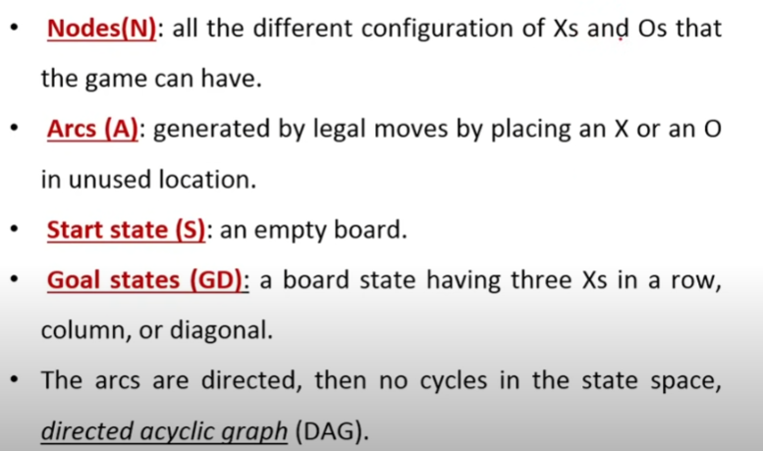
Tic Tac Toe

Slide 3
TH 8-PuZZLE:

Slide 4
THE TRAVELING SALESPERSON
From city A, and return to the same city.
Visit each city once
Notes:
The path [A,D,C,B,E,A], with associated cost of 450 miles,

Slide 5
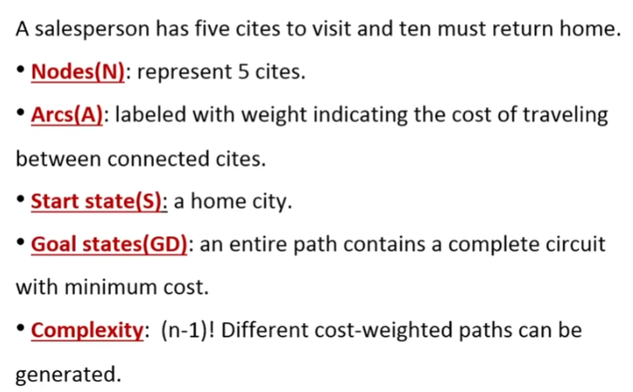
THE TRAVELING SALESPERSON

Slide 6
Cont.
Notes:
As Figure 3.10 suggests, the complexity of exhaustive search in the traveling salespersou
problem is (N - 1)1, where N is the number of cities in the graph. For 9 cities we may
exhaustively try all paths, but for any problem instance of interesting size, for example
with 50 cities, simple exhaustive search cannot be performed within a practical length of
time. In fact complexity for an N! search grows so fast that very soon the search
combinations become intractable.

Slide 7
Cont.
Notes:
Another strategy for controlling search constructs the path according to the rule "go to
Ilsc closest unvisited city." The nearest neighbor path through the graph of Figure 3.11 is
!¥'LE,D,B,C,A], at a cost of 375 miles. This method is highly efficient, as there is only one
l"'th to be tried' The nearest neighbor heuristic is fallible, as graphs exist for which it does
a'll find the shortest path, see Figure 3.11, but it is a possible compromise when the time
required makes exhaustive search impractical.

Slide 8
Strategies for State Space Search
Data-Driven
Forward chaining
Begins with the given facts of the problem and a set of legal moves or rules for changing state.
Search proceeds by applying rules to facts to produce new facts, which are in turn used by the rules to generate more new facts.
This process continues until (we hopel) it generates path that satisfies the goal condition.
Goal-Driven Search
goal-driven reasoning, or backward chaining
Take the goal that we want to solve. See what rules are legal moves could be used to generate this goal and determine what conditions must be true to use them.
These conditions become the new goals, or subgoals, for the search.
Search continues, working backward through successive subgoals until (we hopel) it works back to the facts of the problem.
Notes:
When there are large number of potential goals, cutting of search space-many path vs shortest first Vs Reverse maze solving/ test recommendation against particular diagonosis
As an example of the effect a search strategy can have on the complexity of search,
consider the problem of confirming or denying the statement "I am a descendant of
Thomas Jefferson." A solution is a path of direct lineage between the "I" and Thomas
Jefferson. This space may be searched in two directions, starting with the "1" and working
along ancestor lines to Thomas Jefferson or starting with Thomas Jefferson and working
through his descendants.
Some simple assumptions let us estimate the size of the spaee searched in each
direction. Thomas Jefferson was born about 250 years ago; if we assume 25 years per
generation, the required path will be about length 10. As each person has exactly two
parents, a search back from the "I" would examine on the order of 2ro ancestors. A search
that worked forward from Thomas Jefferson would examine more states, as people tend to
have more than two children (particularly in the eighteenth and nineteenth centuries). Ifwe
assume an average of only three children per family, the search would examine on the order
of 3lU nodes of the family tree. Thus, a search back from the "I" would examine fewer
nodes. Note, however, that both directions yield exponential complexity.

Slide 9
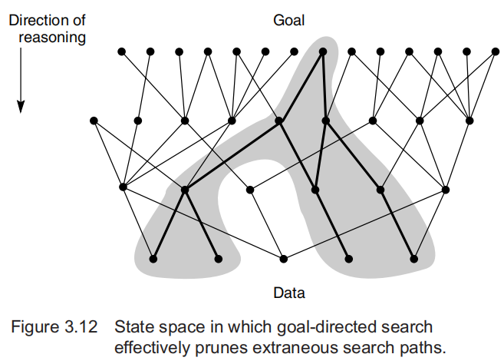
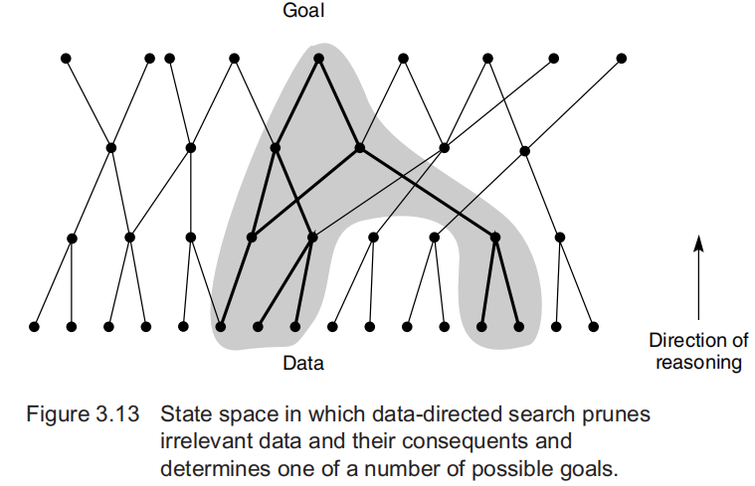
Strategies for State Space Search

Slide 10
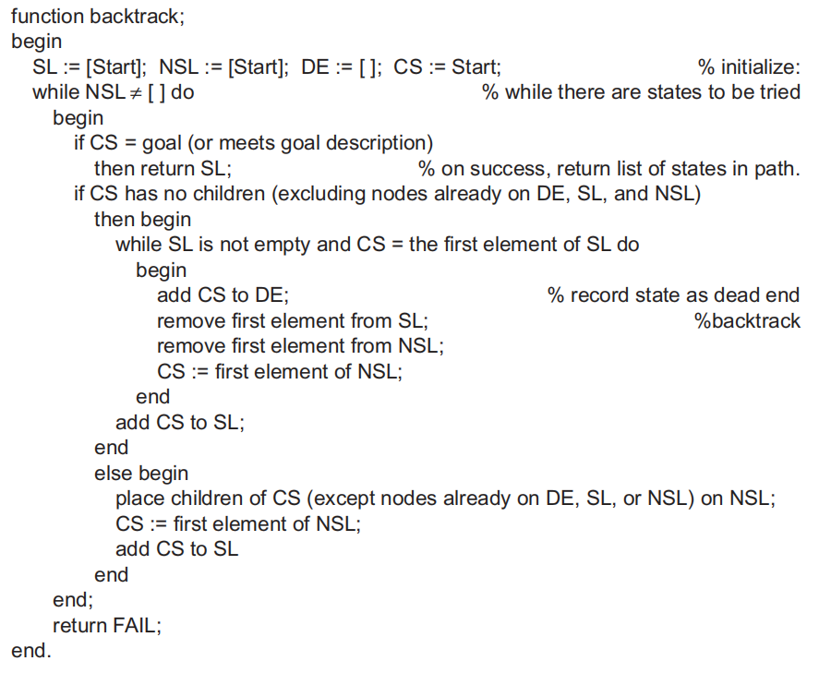
Implementing Graph Search
Notes:
Backtracking search begins at the start state and pursues a path until it reaches either a goal or a "dead end." If it finds a goal, it quits and returns the solution path. If it reaches a dead end, it "backtracks" to the most recent node on the path having unexamined siblings and continues down one of these branches, as described in the following recursive rule:
If the present state S does not meet the requirements of the goal description, then generate its first descendant Schild1' and apply the backtrack procedure recursively to this node. If backtrack doesnot find a goal node in the subgraph rooted at Schild1, repeat the procedure for its sibling, SChild2‘ This continues until either some descendant of a child is a goal node or all the children have been searched. If none of the children of S leads to a goal, then backtrack "fails back" to the parent of S, where it is applied to the siblings of S, and so on,

Slide 11
Cont.
SL, for state list, lists the states in the current path being tried. If a goal is found, SL contains the ordered list of states on the solution path.
NSL, for new state list, contains nodes awaiting evaluation, i.e., nodes whose descendants have not yet been generated and searched.
DE, for dead ends, lists states whose descendants have failed to contain a goal node. If these states are encountered again, they will be detected as elements of DE and eliminated from consideration immediately.
CS for current state. CS is always equal to the state most recently added to SL and represents the "frontier" of the solution path currently being explored.
Notes:
Caution: In defining the backtrack algorithm for the general case (a graph rather than a tree), it necessary to detect multiple occurrences of any state so that it will not be reentered and cause (infinite) loops in the path. This is accomplished by testing each newly generated gate for membership in any of these three lists. If a new state belongs to any of these lists, then it has already been visited and may be ignored.

Slide 12
Example

Slide 13
Trace
Notes:
Data driven search

Slide 14
Cont.
backtrack is an algorithm for searching state space graphs. The graph search algorithms in the remainder of the text, including depth-first breadth-first, and best-first search, exploit the ideas used in backtrack. including:
The use of a list of unprocessed states (NSL) to allow the algorithm to return (backtrack) to any of these states.
A list of "had" states (DE) to prevent the algorithm from retrying useless paths.
A list of nodes (SL) on the current solution path that is returned if a goal is found.
Explicit checks for membership of new states in these lists to prevent looping.

Slide 15
Depth-First and Breadth-First Search
In addition to specifying a search direction (data-driven or goal-driven), a search algorithm must determine the order in which states are examined in the tree or the graph
Notes:
Depth-first search examines the states in the graph of Figure 3. I 5 in the order A, B, E, K, S, L, T, F, M,C, G. N, H, 0, P, U, D, I, Q, J, R. The backtrack algorithm of Section 3.2.2 implemented
A breadth-first search of the graph of Figure 3.15 considers the states in order A, B, C, D, E, F, G, H, I, J, K, L, M, N, 0, P, Q, R, S, T, U.
We implement breadth-first search using lists, open and closed, to keep track of progress through the state space. open, like NSL in backtrack, lists states that have heen generated but whose children have not been examined. The order in which states are removed from open determines the order of the search. closed records states already
examined. closed is the union of the DE and SL lists of the backtrack algorithm.

Slide 16
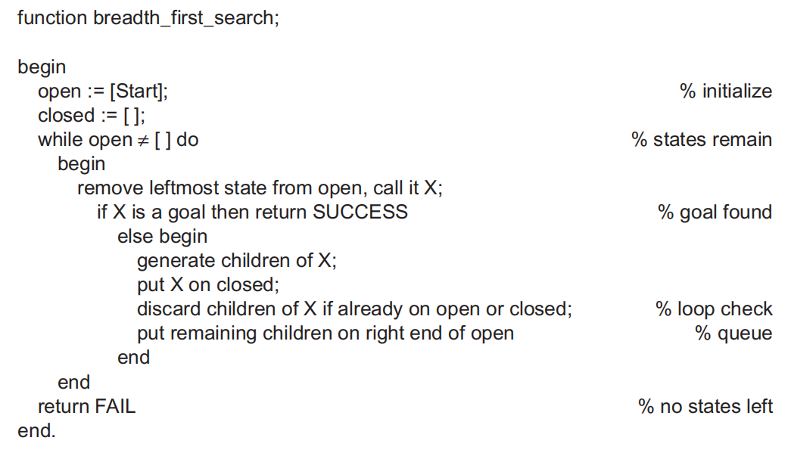
BFS
Notes:
Child states are generated by inference rules, legal moves of a game, or other state
transition operators. Each iteration produces all children of the state X and adds them to
open. Note that open is maintained as a queue, or first-in-first-out (FIFO) data structure.
States are added to the right of the list and removed from the left, This biases search toward
the states that have been on open the longest, causing the search to be breadth-first Child
states that have already been discovered (already appear on either open or closed) are
discarded. If the algorithm terminates because the condition of the "while" loop is no
longer satisfied (open = [ ]) then it has searched the entire graph without finding the desired
goal: the search has failed.

Slide 17
BFS RUN

Slide 18
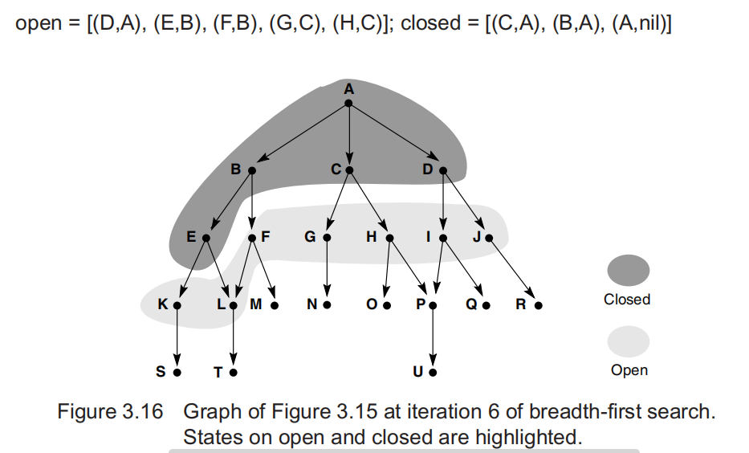
Cont.
Notes:
Because breadth-first search considers every node at each level of the graph before
going deeper into the space, all states are first reached along the shortest path from the start
State, Breadth-first search is therefore guaranteed to find the shortest path from the start
state to the goal. Furthermore, because all states are first found along the shortest path, any
states encountered a second time are found along a path of equal or greater length. Because
there is no chance that duplicate states were found along a better path, the algorithm simply
discards any duplicate states.
?? It is often useful to keep other information on open and closed besides the names of the
states. For example, note that breadth_first_search does not maintain a list of states on the
current path to a goal as backtrack did on the list SL; all visited states are kept on closed.
Ifthe path is required for a solution, it can be returned by the algorithm. This can be done
~~( storing ancestor information along with each state. A state may be saved along with a
record of its parent state, i.e., as a (state, parent) pair. If this is done in the search of Figure
3,15, the contents of open and closed at the fourth iteration would be:

Slide 20
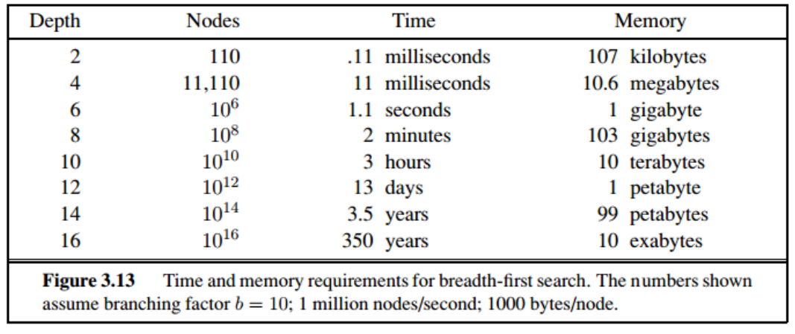
Exponential-complexity search problems cannot be solved by uninformed methods for any but the smallest instances.

Slide 21
DFS

Slide 22
Cont.

Slide 24
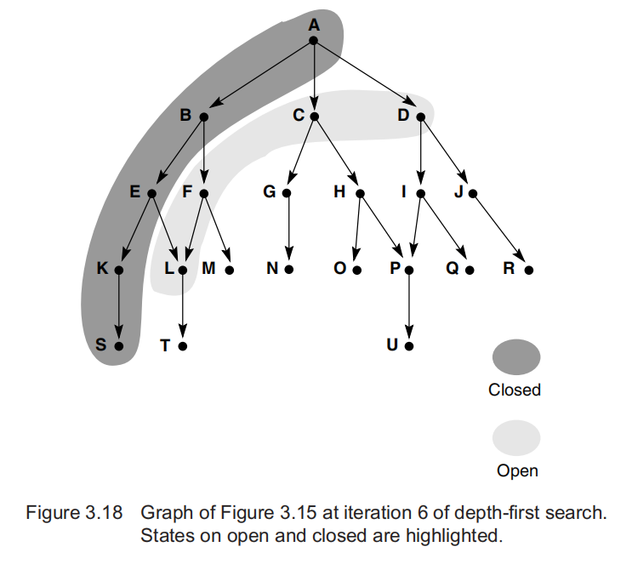
DFS
Notes:
DFS not guaranteed to find the shortest path to a state the first time that state is encountered

Slide 25
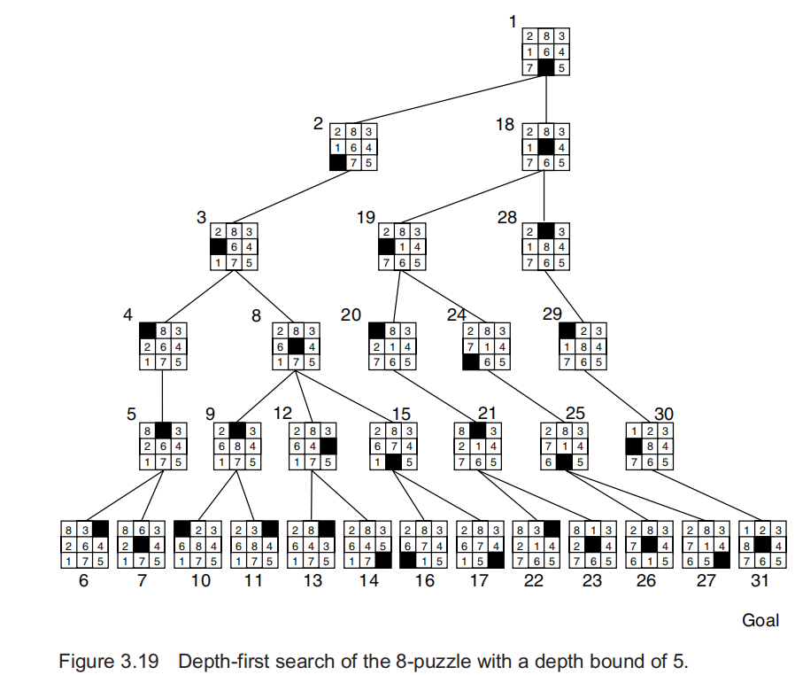
Notes:
Figure 3.19 gives a depth-first search of the 8-puzzle. As noted previously, the space is
generated by the four "move blank" rules (up, down, left, and right). The numbers next to
the states indicate the order in which they were considered, i.e., removed from open. States
left on open when the goal is found are not shown. A depth bound of 5 was imposed on
this search to keep it from getting lost deep iu the space.

Slide 26
DFS
If DFS goes down an infinite branch it will not terminate if it does not find a goal state.
If it does find a solution, there may be a better solution at a lower level in the tree. Therefore, depth first search is neither complete nor optimal.
• DFS may never terminate as it could follow a path that has no solution (e.g., Chess: repeated moves result in similar configuration)

Slide 27
BFS Vs. DFS
As with choosing between data- and goal-driven search for evaluating a graph, the choice of depth-first or breadth-first search depends on the specific problem being solved.
Significant features include the importance of finding the shortest path to a goal, the branching factor of the space, the available compute time and space resources, the average length of paths to a goal node, and whether we want all solutions or only the first solution.
In making these decisions, there are advantages and disadvantages for each approach.

Slide 28
BFS Vs. DFS
BFS always examines all the nodes at level n before proceeding to level n + 1,
In a problem where it is known that a simple solution exists, this solution will be found
breadth-first search always finds the shortest path to a goal node
space utilization of BFS, measured in terms of the number of states on open, is an exponential function of the length of the path at any time
B^n states on level n, BFS would place all of these on open when it begins examining level n
Depth-first search gets quickly into a deep search space.
If it is known that the solution path will be long, depth-first search will not waste time searching a large number of “shallow” states in the graph
On the other hand, depth-first search can get “lost” deep in a graph, missing shorter paths to a goal or even becoming stuck in an infinitely long path that does not lead to a goal.
DFS is much more efficient for search spaces with many branches because it does not have to keep all the nodes at a given level on the open list.
The space usage of DFS is a linear function of the length of the path
If a graph has an average of B children per state, this requires a total space usage of B × n states to go n levels deep into the space.

Slide 29
Depth-First Search with Iterative Deepening
This form of search is an excellent compromise between depth-first and breadth-first searches.
The search sets a depth limit/bound and then does a depth-first search down to this limit - if a solution is found it exits with success.
If a solution is not found then the limit is increased and the search run again but down to this new depth.
Obviously, a large number of nodes are revisited a number of times, but the overall loss due to this becomes insignificant for a search through a large tree.
The number of nodes grows exponentially as you go down the tree so almost all the time is spent at the deepest levels which are only visited once unless the search repeats to a deeper level, at which the time spent in these levels will become insignificant.
The memory consumption is the same as that for a depth-first search, but the search is always guaranteed to find a solution, as in breadth-first search.

Slide 30
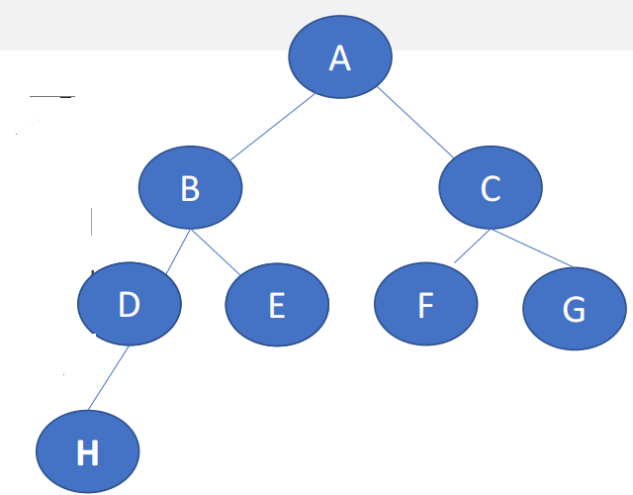
Iterative Deepening search
guaranteed to find a shortest path to a goal. Because it does only depth-first search at each iteration,
the space usage at any level n is B × n, where B is the average number of children of
a node.

Slide 31
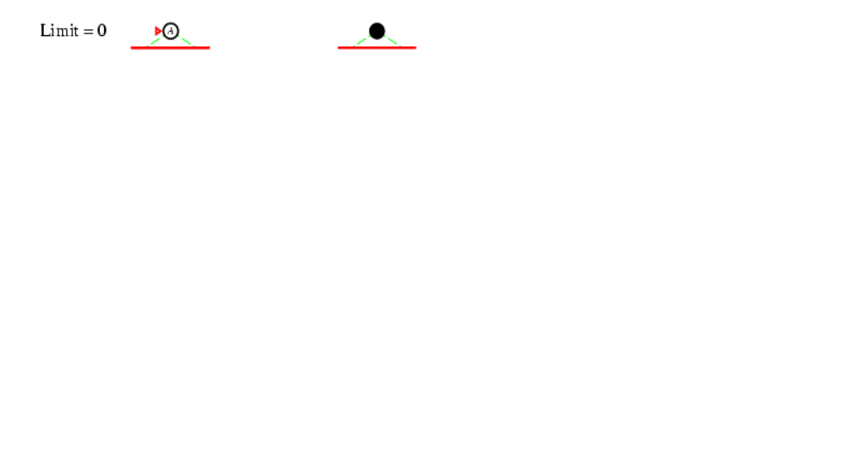
Iterative Deepening search d=0

Slide 32
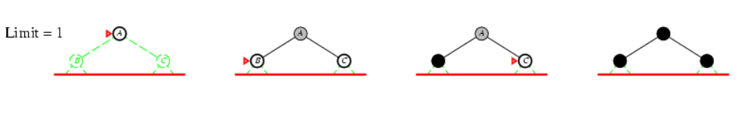
Iterative Deepening search d=1

Slide 33
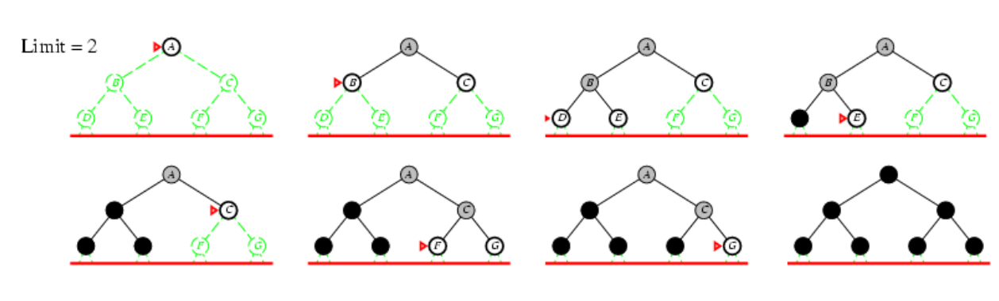
Iterative Deepening search d=2

Slide 34
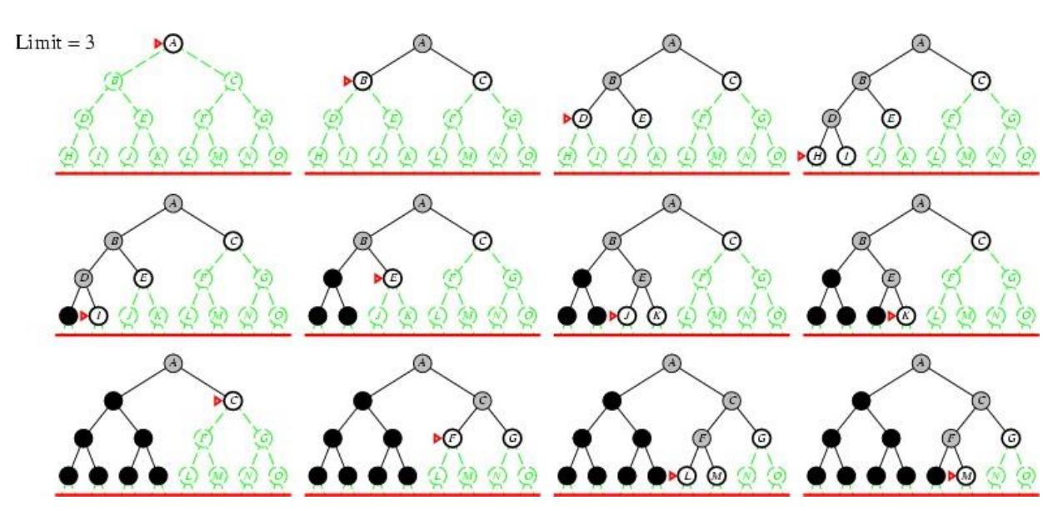
Iterative Deepening search d=3

Slide 35
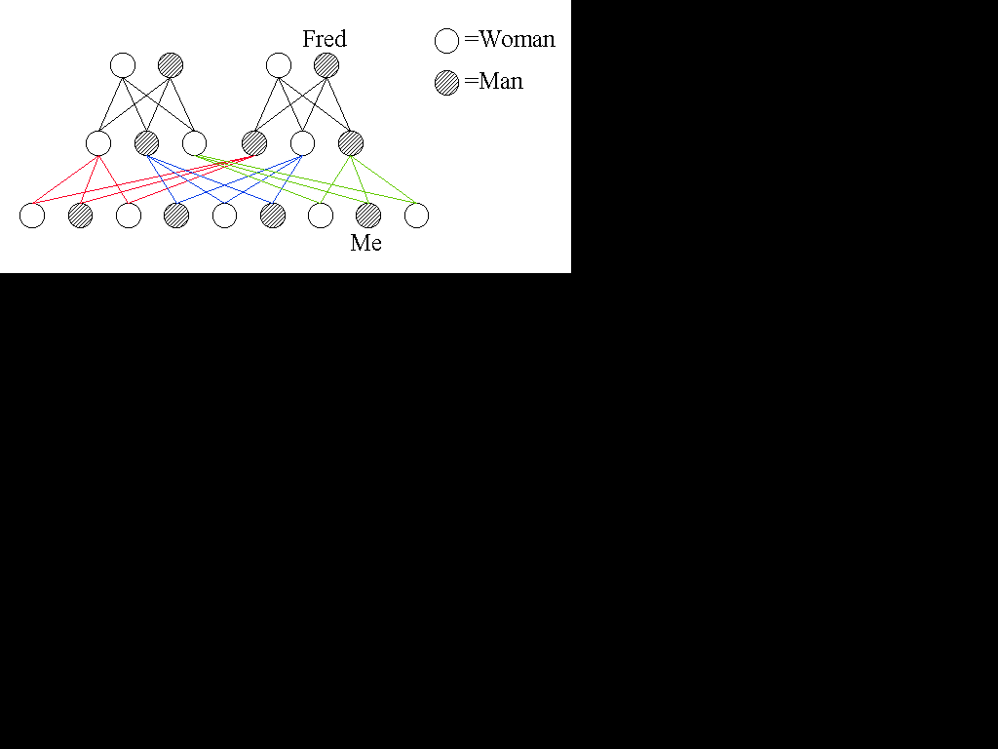
Direction of Search
Sometimes, the direction of the search will make a difference to the size of the search. It may be that there are less nodes to consider if you search back from the goal node up to the start node.
A search algorithm attempting to find out if I am a descendant of Fred can take two different routes.
It can start at Fred and work it way down, or it can start at me and work its way up. All I am interested is in finding a route between Fred and myself.
So let's look at a top to bottom search, starting with Fred and attempting to find me.

Slide 36
Direction of Search
Going down the tree we see that there are three nodes to check at level one.
From these three, there are a further nine nodes to check, so we may have to check up to 12 nodes, excluding Fred.
If we go up the tree starting at Me, we see that one level up there are two nodes to examine, my parents.
Going on from my parents, there are four more nodes - my grandparents of whom Fred is one.
Going up the tree I only have to consider 6 nodes as opposed to 12.
If John wants to find out if he is a descendant of Ethel, who is not two but 5 generations away the difference becomes even more noticeable.
The top-down approach would have to consider up to 363 nodes whereas the bottom-up approach would only have to consider 62 at the most - a significant difference.

Slide 37
Direction of Search
Why is this?
Well it's all in the branching factor,
for the top-down approach the branching factor is 3 - each couple has three children -so at level n there are 3^n nodes to consider.
The branching factor the other way is 2 as each person has only two parents, thus n levels up the tree from the start there are 2^n nodes to consider.
So if you have a tree with one average branching factor one way and a smaller average the other way, and if you are free to solve the problem in either direction, it is probably advisable to try solving it going in the direction that gives the least branching factor.

